Slide 1
What works for whom?
Evidence-Based Best Practices in Juvenile Delinquency Interventions
Jodi Petersen, PhD
jodi@petersenresearchconsultants.com

Slide 2
Upcoming Trainings
Quality Assurance in Action: What do we mean and how do we implement?
April 26

Slide 3
Today’s Topics
Importance of Evidence-Based Programming
Understanding the Research
Applying the Evidence
“Off the Shelf” Programming
Promising Practices
Creating New Programs
Fidelity & Data Tracking

Slide 4
Why do we talk about evidence-based programming?
Life Circumstances & Response Patterns
Behaviors

Slide 5
Why do we talk about evidence-based programming?
Criminogenic Risks
Engaging in Crime
Intervention

Slide 6
Why do we talk about evidence-based programming?
Criminogenic Risks
Engaging in Crime
Intervention

Slide 7
Why do we talk about evidence-based programming?
Good programs will reduce criminogenic risk
Secondary goals: improve responsivity, strengthen protective factors
Remember the Risk-Need-Responsivity (Protective Factors) Principle
Risk – Greater risk = Greater intervention
Need – Match intervention to area of risk
Responsivity – ”Motivation, Matching, Mountains” considerations are prerequisites for intervention
Protective Factors – Maintain & scaffold

Slide 8
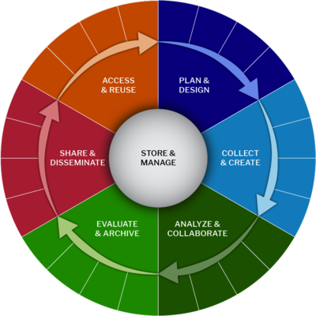
Evidence-Based Best Practices
Evidence (empirical research) has shown that X program produces Y results consistently.
Be sure to look for “effective for….”
In this context, Y = reduction in risk or recidivism
Notes:
The practice is rated Effective for improving youths’ internalizing symptoms, externalizing symptoms, and interpersonal skills.

Slide 9
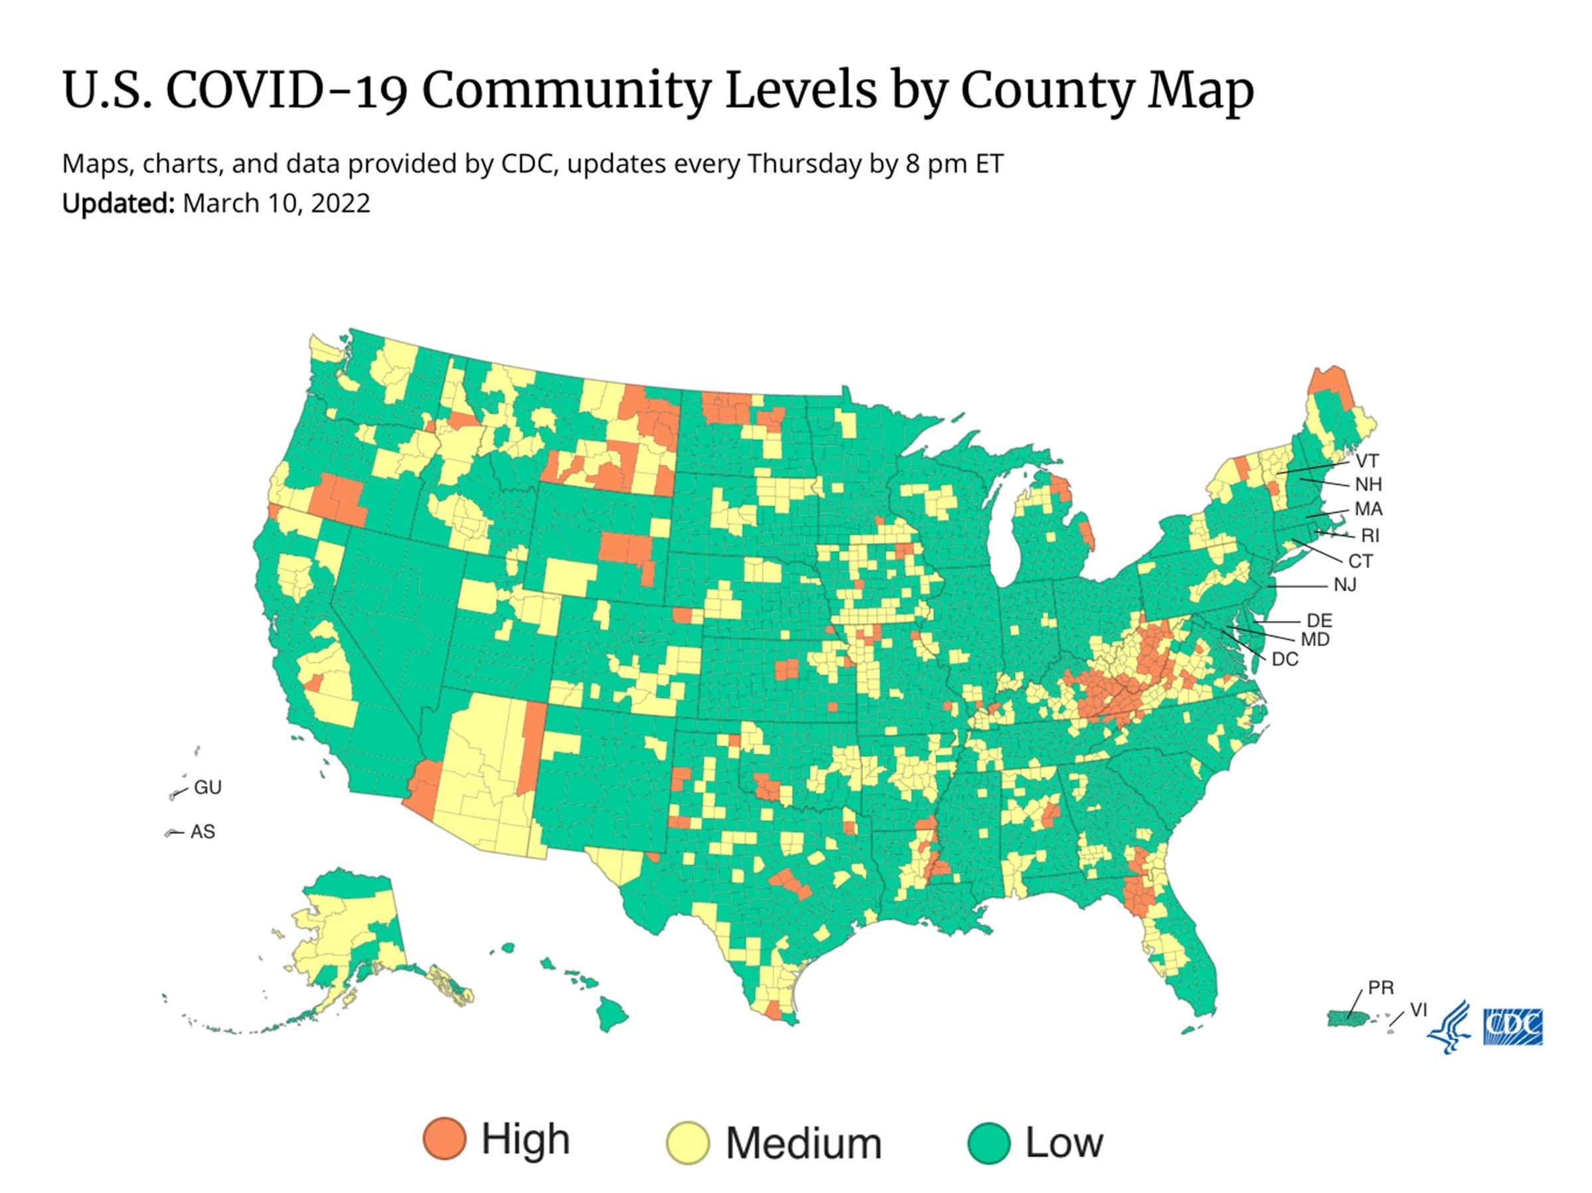
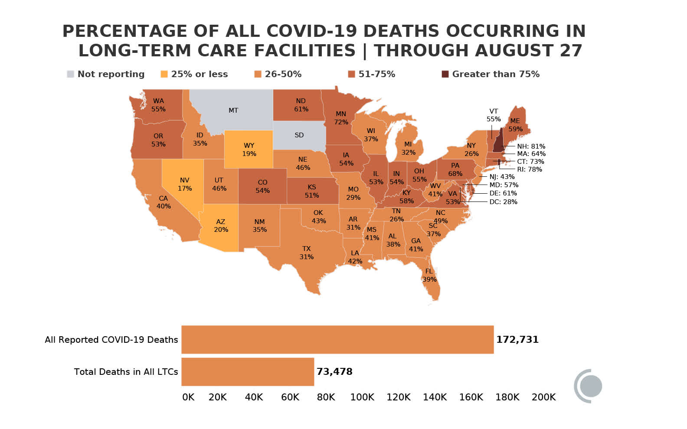
Why does this matter??

Slide 10
How good is a chocolate chip cookie?
How is good defined?
Who defined it?
Who is cooking the cookies?
How are they being made?
How are they being consumed?
Are the cookies consistent?
Are the raters rating consistently?

Slide 11
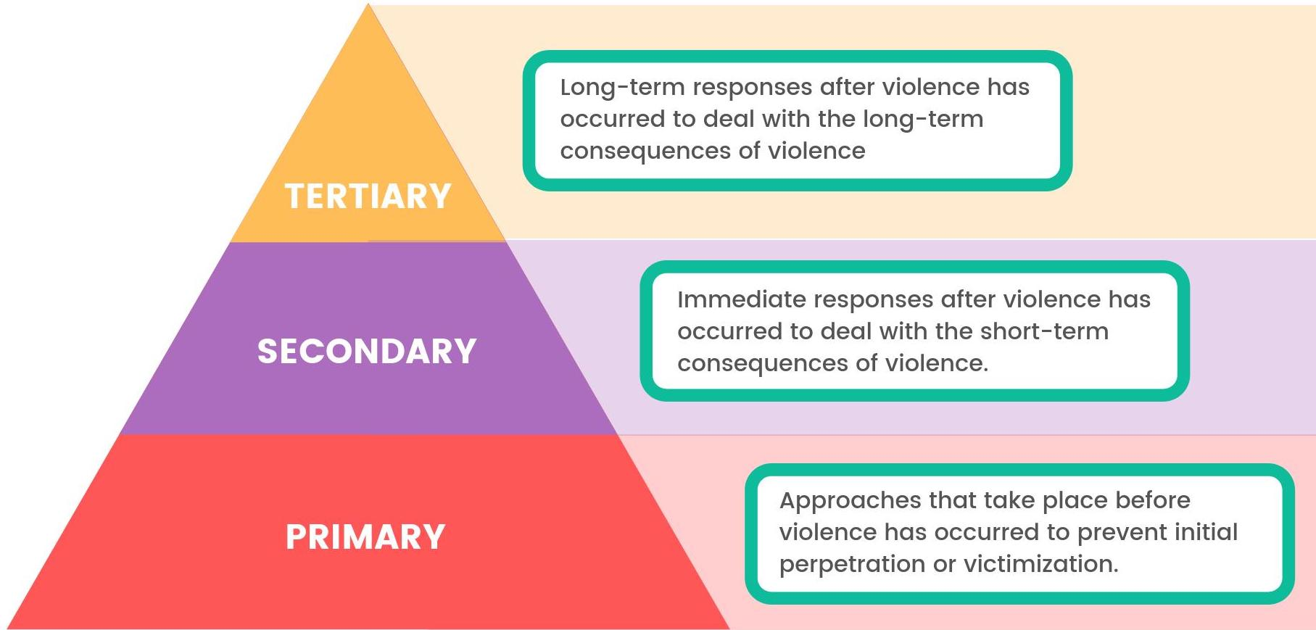
Whom is the intervention for?

Slide 12
Whom is the intervention for?
Does the intervention work equally for all juveniles? Probably not!
Responsivity -> Matching
Look for subgroup differences
Responsivity
Process
Outcomes

Slide 13
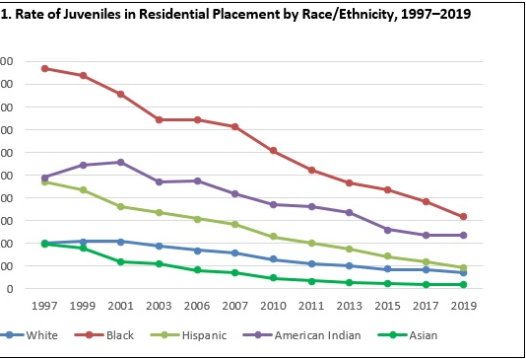
Notes:
https://ojjdp.ojp.gov/model-programs-guide/literature-reviews/racial-and-ethnic-disparity

Slide 14
Who decides what meets the threshold?
It depends. There is no one authority on this.
Direction under Mi JJ Reform is under development
OJJDP: Model Programs Guide / NIJ’s CrimeSolutions.ojp.gov

Slide 15
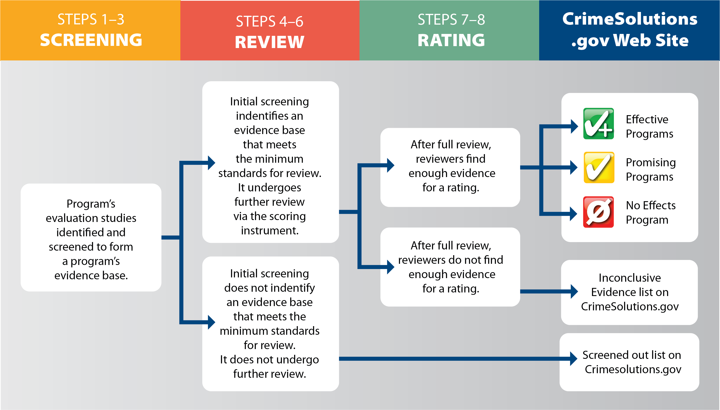

Slide 16
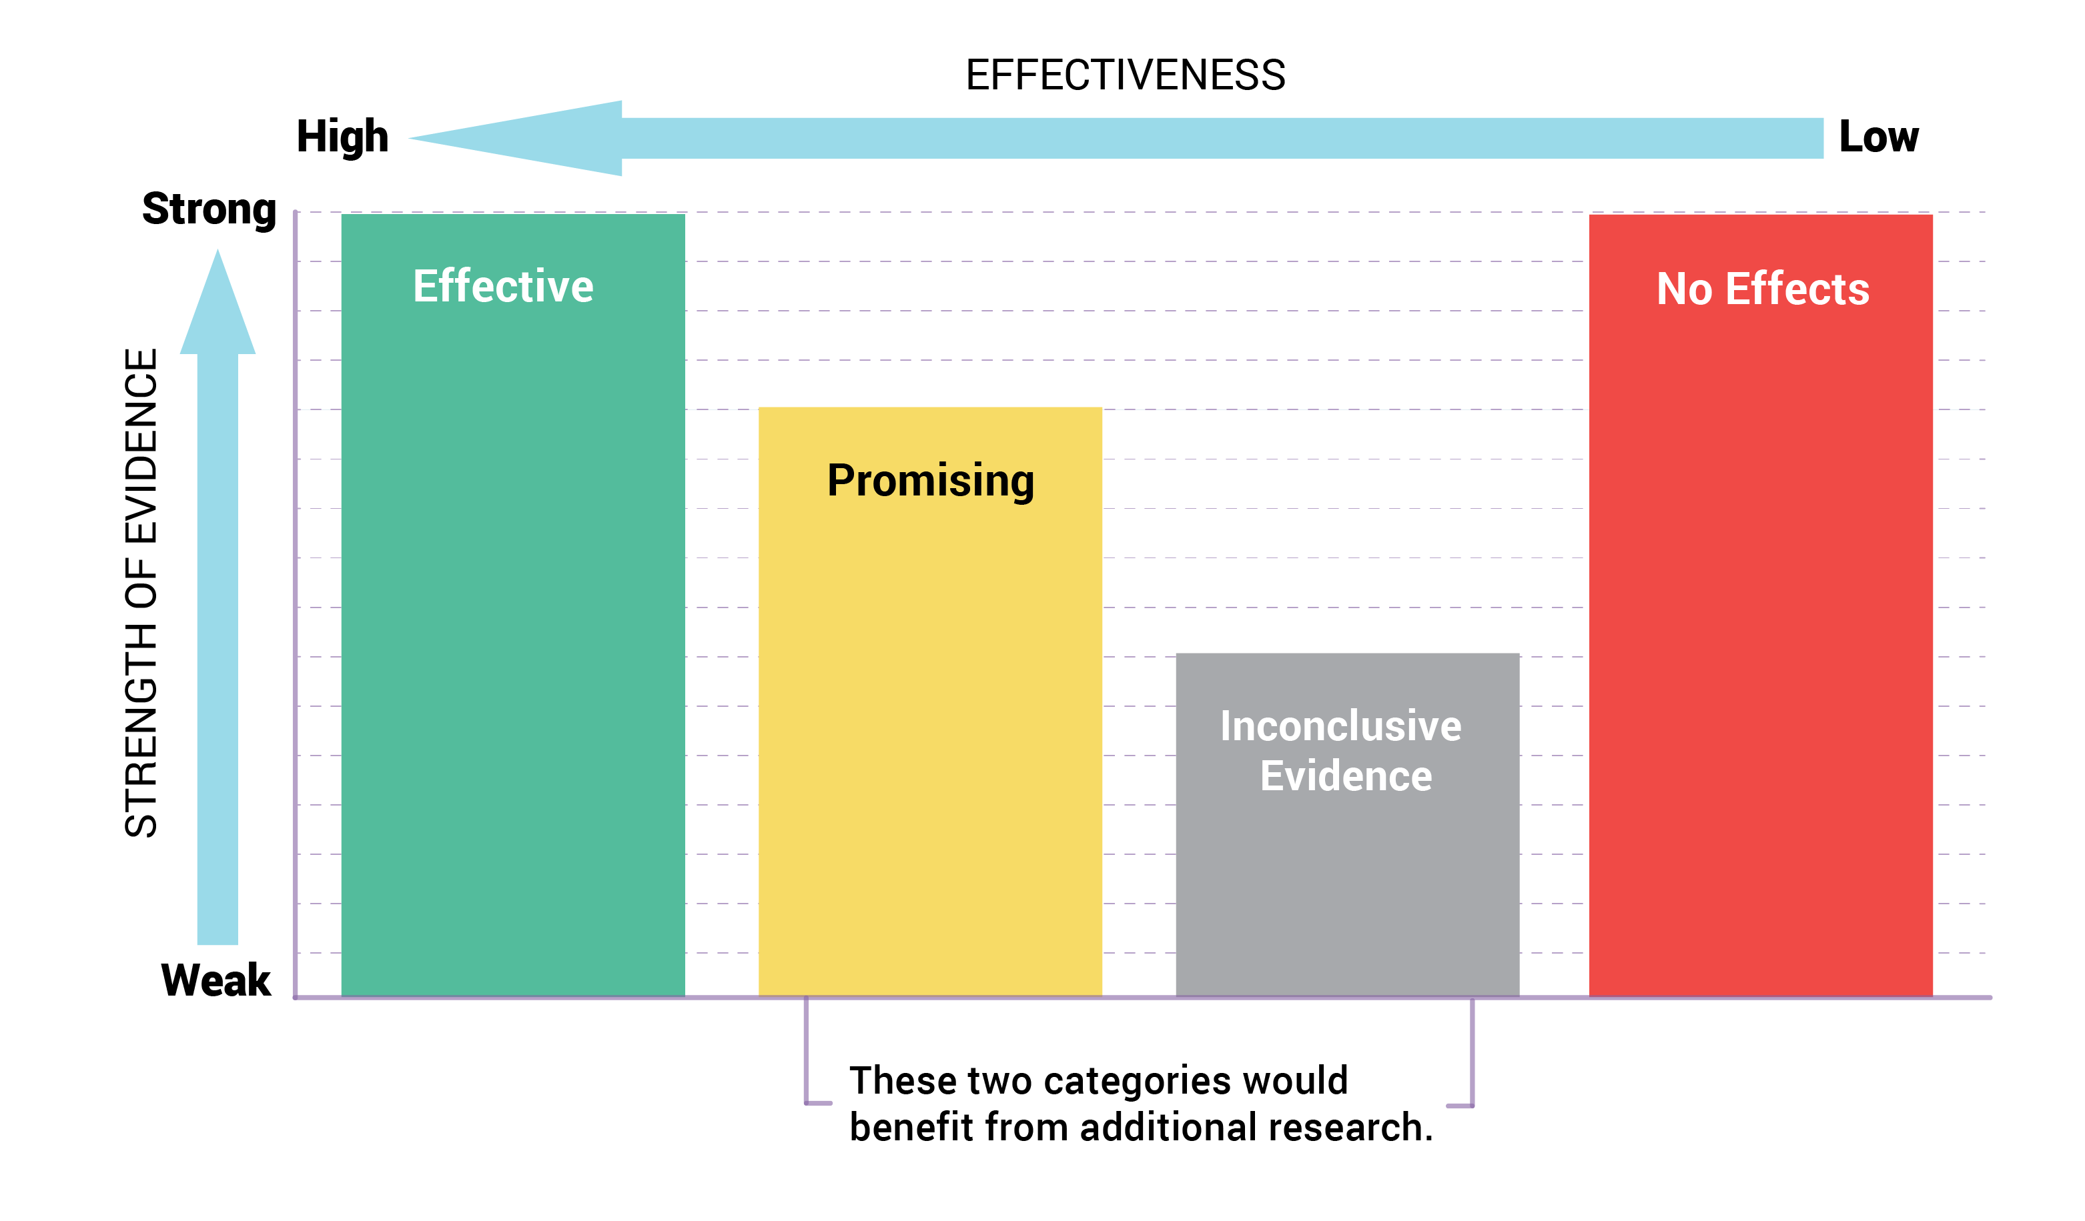

Slide 17
OJJDP: Programs vs Practices
Program: A specific set of activities carried out according to guidelines to achieve a defined purpose.
Practices: A general category of programs, strategies or procedures that share similar characteristics with regard to the issues they address and how they address them.

Slide 18
OJJDP Review Rubric
Conceptual Framework
Prior Research
Theoretical Bias
Program Description
Design Quality
Research Design
Sample Size (Power)
Statistical Adjustment (Controls)
Instrumentation
Internal Validity
Follow Up Period
Displacement/Diffusion/Anticipatory Benefits

Slide 19
OJJDP Review Rubric
Program Fidelity
Documentation
Adherence
Outcome Evidence
Substantive Program Effects
Behavior
Reviewer Confidence/Override

Slide 20
Implementing “Off The Shelf” Programming
Fidelity
To achieve the results evidence supports, the program must be implemented as it was in the study
Same curriculum, processes, measurement, etc

Slide 21
Customizing “Off The Shelf” Programming
What NEEDS to change and why?
What is the evidence base for what you’re changing?
What is the impact of what you’re taking away/adding/revising?
How will you track & measure that impact?
Is this still evidence-based? Evidence-informed? A promising practice?

Slide 22
Creating New Programs
Have a clear theory of change and/or logic model
Documented, intentional program model
Based in existing evidence and/or strong theory
Implement with consistency
Track and measure impact
Revise as needed

Slide 23
Characteristics of Best Practice Programs
Individual studies vs meta analyses
Mark Lipsey @ Vanderbilt University
Meta Analysis Database – nearly 600 studies!

Slide 24
Characteristics of Best Practice Programs
Effective programs:
Target high risk cases (risk principle)
Use a therapeutic approach focusing on development, not control
Are based in research and can show effectiveness
Are well-implemented

Slide 25
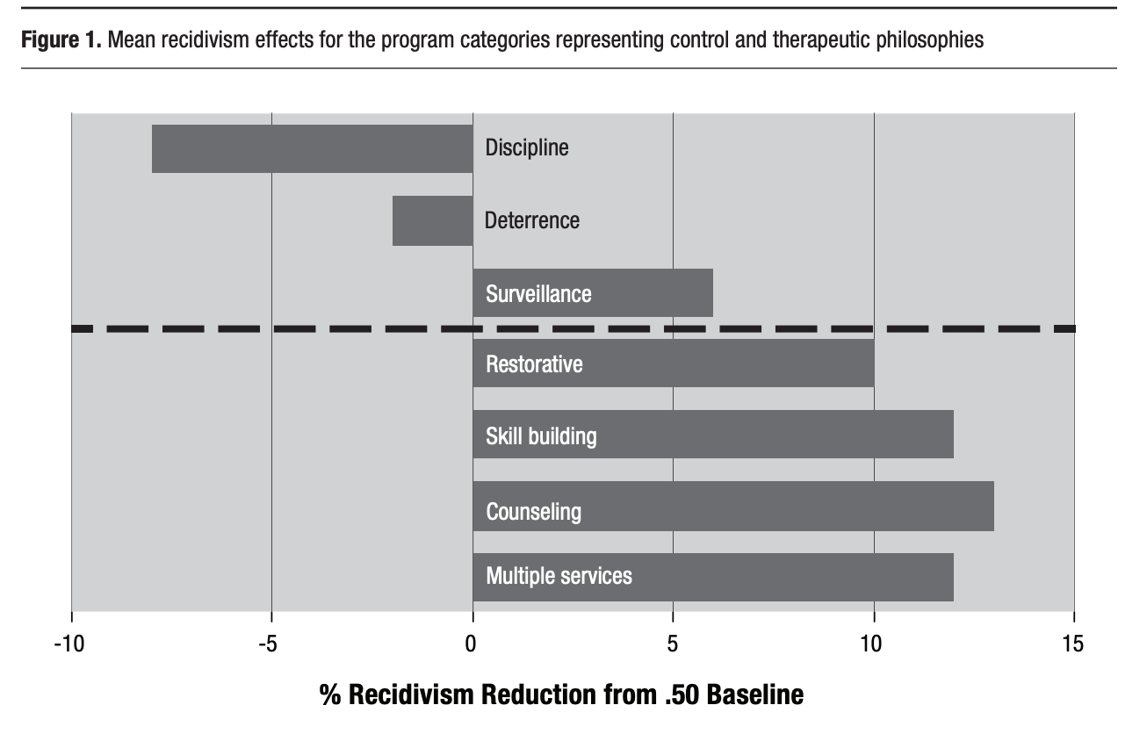
Characteristics of Best Practice Programs

Slide 26
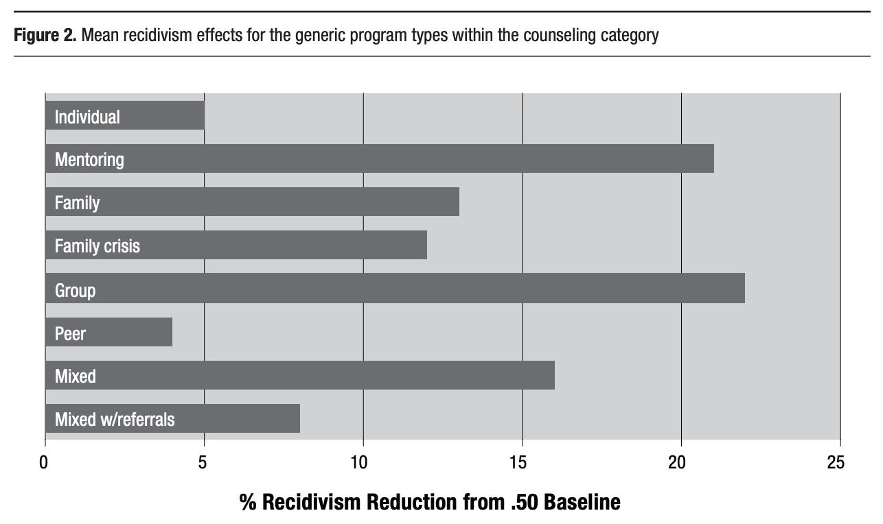
Characteristics of Best Practice Programs

Slide 27
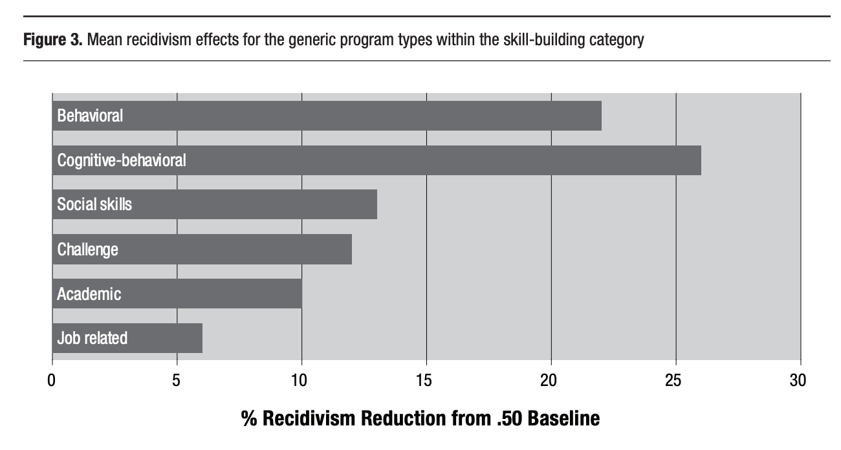
Characteristics of Best Practice Programs

Slide 28
Characteristics of Best Practice Programs
Intervene early, interrupt developmental pathways
Don’t confuse public safety with appropriate treatment
Adequate intensity and sufficient duration to address ”entrenched problem behavior patterns” (Greenway, 1994)
Integrate youth into generally pro-social groups
Address thought processes that rationalize negative behaviors in an effort to change those behaviors (CBT)

Slide 29
Characteristics of Best Practice Programs
Approximately 5-8 hours per week of treatment time
3-6 months of intervention
Linked continuum of care
Transition to community supports
Involve family/social supports

Slide 30
How Can We Truly Reduce Recidivism ?
Target Criminogenic Risk Factors
Address individual characteristics (responsivity) and enhance protective factors
Develop / Modify programs to meet best practice tenants and reflect risk assessment identified needs

Slide 31
How Can We Truly Reduce Recidivism ?
Involve youth and family in treatment process
Train referring parties and court/county systems in YLS and research-based practice
Implement ‘Dosage Driven Treatment’
Successful completion is based on changing risk assessment score

Slide 32
How Can We Truly Reduce Recidivism ?
Implement treatment programming that primarily use cognitive-behavioral and social learning strategies
Establish a research component to track recidivism data
Transition youth to community supports toward end of treatment

Slide 33
Questions & Discussion

